Slide 1
Chapter 1 : Introduction to Software Requirements Engineering
Source of PP slides :
Lamsweerde, A. V. 2011. Requirements Engineering: From System goals to UML Models to Software Specification. 2nd ed.Wiley.

Slide 2
Lesson objectives:
To explain what is requirement engineering
To understand why engineer requirements
To describe the obstacles to good requirements engineering practice
To understand Agile development processes and requirement engineering

Slide 3
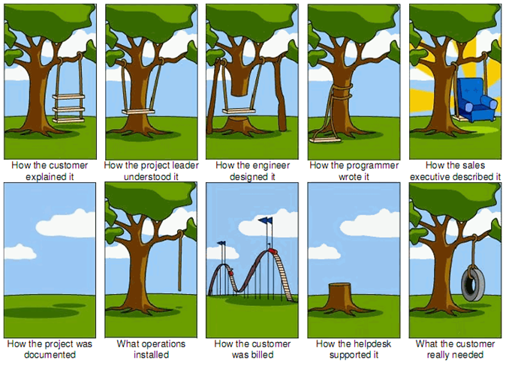
What is requirement engineering ?

Slide 4

What is requirement engineering?
The problem world and the machine solution
To make sure a software solution “correctly” solves some real-world problem, we must first fully understand and define ...
what problem needs to be solved in the real world
the context in which the problem arises
Example: car control
Problem: manual handbrake release can be inconvenient in certain situations
Context: car driving, braking, safety rules, ...

Slide 5
What is Requirement Engineering ?
RE is a set of activities producing the requirements on a software-intensive system
for the system objectives, functionalities, target qualities, constraints, assumptions
based on problems raised by the system-as-is and opportunities provided by new technologies
Requirements quality assurance is a key concern for software quality assurance
elicitation, evaluation, specification, analysis, evolution management

Slide 6
So, Requirement Engineering is…
Identify & analyze problems with an existing system (system-as-is),
Identify & evaluate objectives, opportunities, options for new system (system-to-be),
Identify & define functionalities of, constraints on, responsibilities in system-to-be,
Specify & organize all of these in a requirements document to be maintained throughout system evolution
System = software + environment
(people, devices, other software)

Slide 7
Example: (Let’s discuss…) Transportation between airport terminals
Problem (system-as-is):
passengers frequently missing flight connections among different terminals; slow & inconvenient transportation
number of passengers regularly increasing
Objectives, options (system-to-be):
support high-frequency trains between terminals
with or without train drivers ?
Functionalities, constraints:
software-based control of train accelerations, doors opening etc. to achieve prompt and safe transportation
RE deliverable:
Requirements Document (RD) for system-to-be

Slide 8
Requirements in the software lifecycle
Getting
the
right
system
Requirements engineering
Software design
Getting
the
software
right
Software implementation
Software evolution

Slide 9
Other definition of RE…
Ross'77
Requirements definition must say ...
why a new system is needed, based on current or foreseen conditions,
what system features will satisfy this context,
how the system is to be constructed
RE is concerned with the real-world goals for, functions of, constraints on software systems; and with their
link to precise specifications of software behavior,
evolution over time and families
Zave'97

Slide 10
The scope of RE: the WHY, WHAT, WHO dimensions
System-as-is
System-to-be
WHY
a new system?
problems,
opportunities,
system knowledge
Objectives
satisfy
requirements,
constraints,
assumptions
WHAT
services?
assign
WHO
will be responsible
for what ?

Slide 11
The WHY dimension
?
Identify, analyze, refine the system-to-be’s objectives
to address analyzed deficiencies of the system-as-is
in alignment with business objectives
taking advantage of technology opportunities
Example: airport train control
“Serve more passengers”
“Reduce transfer time among terminals”
Difficulties
Acquire domain knowledge
Evaluate alternative options (e.g. alternative ways of satisfying the same objective)
Match problems-opportunities, and evaluate these: implications, associated risks
Handle conflicting objectives

Slide 12
The WHAT dimension
?
Identify & define the system-to-be’s functional services (software services, associated manual procedures)
to satisfy the identified objectives
according to quality constraints: security, performance, ...
based on realistic assumptions about the environment
Example: airport train control
“Computation of safe train accelerations”
“Display of useful information for passengers inside trains”
Difficulties
Identify the right set of features
Specify these precisely for understanding by all parties
Ensure backward traceability to system objectives

Slide 13
The WHO dimension
?
Assign responsibilities for the objectives, services, constraints among system-to-be components
based on their capabilities and on the system’s objectives
yielding the software-environment boundary
Example: airport train control
“Safe train acceleration” ... under direct responsibility of software-to-be (driverless option) or of driver following software indications ?
“Accurate estimation of train speed/position” ... under responsibility of tracking system or of preceding train ?
Difficulties
Evaluate alternative options to decide on the right degree of automation

Slide 14
Ex: (Let’s Discuss …) SCOPe of RE : WHY, WHAT, WHO dimensions for a library system
WHY –
WHAT –
WHO –

Slide 15
Categories of requirements (1)
Functional requirements:
- prescribe what services the software-to-be should provide
capture intended software effects on environment, applicability conditions
units of functionality resulting from software operations
Eg: “The software shall control the acceleration of all trains”

Slide 16
Categories of requirements (2)
Non-functional requirements:
- constrain how such services should be provided
Defines constrains on the way the software should satisfy its functional requirements/ on the way it should be developed
Eg: “Acceleration commands shall be issued every 3 seconds to every train”
Figure in next slide outlines one typical classification of non-functional requirements, ie..
Quality requirements: safety, security, accuracy, time/space performance, usability, ...
Compliance requirements: …
Architectural requirements: …
Development requirements: …

Slide 17
A taxonomy of non-functional requirements
Non-Functional Requirement
Quality of Service
Compliance
Architectural Constraint
Development Constraint
Accuracy
Safety
Security
Reliability
Performance
Interface
Installation
Distribution
Cost
Maintainability
Cost
Deadline
Variability
Confidentiality
Integrity
Availability
Time
Space
User
Device
Software
interaction
interaction
interoperability
Subclass link
Usability
Convenience
(See definitions and examples in the book)
No clear-cut boundaries, possible overlaps …
Functional/non-functional: e.g. functional reqs for firewall management are security-related (non functional req)
Non-functional overlaps: e.g. “high frequency of train commands” is related to performance and safety

Slide 18
Requirements taxonomies are helpful ...
More specific definition of what requirements are in specific classes
More semantic characterization of requirements ...
prescribing desired behaviors e.g. many functional reqs
ruling out inadmissible behaviors e.g. many safety, security, accuracy reqs
indicating preferred behaviors e.g. soft, “ility” reqs
Elicitation/analysis can be guided by taxonomy browsing
Is there any confidentiality req on information X ?
Is there any accuracy req on information Y ?
Is there any conflict between confidentiality and accountability reqs in my system?

Slide 19
Categories of requirements (3)
Other classification of requirements:
- Product requirements
Is a need or constraint on the software to be developed
Eg: “The software shall verify that a student meets all pre-requirements before he or she registers for a course”
- Process requirements
Is essentially a constraint on the development of the software
Eg: “The software shall be developed using Waterfall Development Process”

Slide 20
The RE process (1)
alternative proposals
domain understanding
& elicitation
start

Slide 21
Domain understanding
Studying the system-as-is
Business organization: structure, dependencies, strategic objectives, policies, workflows, operational procedures, ...
Application domain: concepts, objectives, tasks, constraints, regulations, ...
Strengths & weaknesses of the system-as-is
Identifying the system stakeholders:
Groups or individuals affected by the system-to-be, who may influence its elaboration and its acceptance
Decision makers, managers, domain experts, users, clients, subcontractors, analysts, developers, ...
Products: Initial sections for preliminary draft proposal
Glossary of terms

Slide 22
Requirements elicitation
Exploring the problem world ...
Further analysis of problems with system-as-is: symptoms, causes, consequences
Analysis of technology opportunities, new market conditions
Identification of ...
improvement objectives
organizational/technical constraints on system-to-be
alternative options for satisfying objectives, for assigning responsibilities
scenarios of hypothetical software-environment interaction
requirements on software, assumptions on environment
Product: Additional sections for preliminary draft proposal

Slide 23
The RE process (2)
alternative proposals
domain understanding
evaluation
& elicitation
& agreement
start
agreed
requirements

Slide 24
Evaluation & agreement
Negotiation-based decision making ...
Identification & resolution of conflicting concerns
Identification & resolution of risks with proposed system
Comparison of alternative options against objectives & risks, and selection of preferred ones
Requirements prioritization: to resolve conflicts, address cost/schedule constraints, support incremental development
Product: Final sections of draft proposal documenting the selected/agreed objectives, requirements, asssumptions (incl. rationale for selected options)

Slide 25
The RE process (3)
alternative proposals
domain understanding
evaluation
& elicitation
& agreement
start
agreed
requirements
specification
& documentation
documented requirements

Slide 26

Specification & documentation
Precise definition of all features of the agreed system
Objectives, concepts, relevant domain properties, system/software requirements, assumptions, responsibilities
Satisfaction arguments, rationale for options taken
Likely system variants & evolutions
Estimated costs
Organization of these in a coherent structure
Documentation in a form understandable by all parties
Products: Requirements Document (RD)

Slide 27
The RE process (4)
alternative proposals
domain understanding
evaluation
& elicitation
& agreement
consolidated
start
agreed
requirements
requirements
validation
specification
& verification
& documentation
documented requirements

Slide 28
Validation & Verification / Requirements Consolidation
Quality assurance activity on RD ...
Validation: adequacy of RD items wrt real needs ?
Verification: omissions, inconsistencies ?
Checks for other target qualities (discussed next)
Fixing of errors & flaws
Products: Consolidated RD, Acceptance test data, prototype, Development plan, Project contract

Slide 29
RE: an iterative process
RE phases are ordered by data dependencies
No strict sequencing: intertwining, overlap, backtracking
Iterated cycles due to error corrections & evolving needs
during RE, during software development, after deployment
alternative proposals
domain understanding
evaluation
& elicitation
& agreement
consolidated
start
agreed
requirements
requirements
validation
specification
& verification
& documentation
documented requirements

Slide 30
why engineer Requirements?
Perhaps …
Fewer defects in requirements and the development product
Reduced development rework
Fewer unused or unnecessary features
Reduced project chaos
Lower enhancement/ maintenance costs
Better customer satisfaction
Etc
Let’s discuss in the following slides ….

Slide 31
The requirements problem: facts, data, citations
Poor requirements are ubiquitous ...
“Requirements need to be engineered and have
continuing review and revision”
Prohibitive cost of late correction ...
“Up to 200 x cost of early correction”
RE is hard & critical ...
“Hardest, most important function of SE is the iterative extraction & refinement of requirements”
Bell&Thayer ’76
Boehm ’81
Brooks ’87

Slide 32
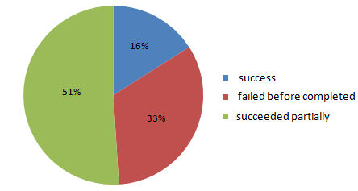
The requirements problem: Standish report, 1995
Survey of 350 US companies, 8000 projects
(partial success = partial functionalities, excessive costs, big delays)
Major source of failure:
Poor requirements engineering ≅ 50% responses

Slide 33
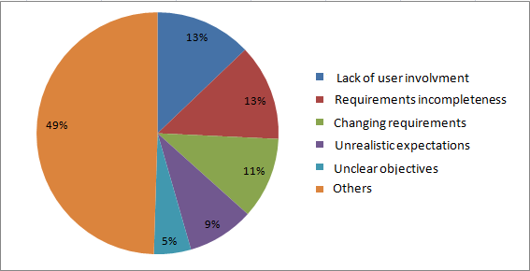
The requirements problem: Standish report, 1995 (2)
Major source of failure:
poor requirements engineering ≅ 50% responses:
www.standishgroup.com/chaos.html

Slide 34

The requirements problem: European survey, 1996
Coverage: 3800 EUR organizations, 17 countries
Main software problems perceived to be in...
requirements specification
> 50% responses
requirements evolution management
50% responses
[European Software Institute, 1996]

Slide 35
The requirements problem is perceived to persist in spite of progress in software technology
Failure %
100
other causes
50
requirements-related
0
1994
2000
2003
[J. Maresco, IBM developersWork, 2007]

Slide 36
Requirements-related errors are ...
the most numerous
± 40% of software errors
the most persistent
found very late, often after software delivery
the most expensive
cost ... 5x more if fixed during design
10x more if fixed during implementation
20x more if fixed during integration testing
200x more if fixed after delivery
account for 66% of software error costs
[Boehm, Jones, Lutz, Hooks & Farry, ...]

Slide 37
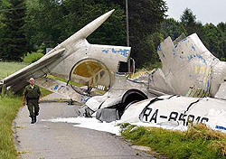
Requirements-related errors can be dangerous
US Aegis/Vincennes (1988): shooting of IranAir airbus
Missing timing between 2 threat events in requirements on alarm software
Patriot anti-missile system (1st Gulf war)
Hidden assumption on maximum usage time
London Ambulance System (1993): fatal delays
Wrong assumptions on crew behavior, ambulance localization system, radio communication, ...
Boeing 757 crash, Cali (1995)
Autopilot ’s wrong timing/localization assumption on flap extension point
Cf. ACM RISKS Digest Forum website

Slide 38
Role and stakes of RE
Technical impact
on many software-related artefacts (as seen before)
Managerial impact
basis for communication among parties and for project management
Legal impact
contractual commitment client-provider-subcontractors
Impact on certification
Mastered RE process required by many quality standards & certification authorities

Slide 39
Role and stakes of RE (2)
Impact on economy, security, and safety
Cost and consequences of errors in requirements on the software-to-be, assumptions about its environment
Social impact
from user satisfaction
to degradation of working conditions
to system rejection

Slide 40
Obstacles to good RE practice
i) RE efforts often spent without guarantee of project contract being concluded
ii) Pressure on tight schedules, short-term costs, catching up on technology
iii) Too little work available on RE economics
Lack of quantitative data on RE benefits & cost savings
Progress in RE process is harder to measure than in design, implementation
iv) RDs are sometimes felt ...
big, complex, to be quickly outdated
too far away from the executable product customers are paying for
How about other obstacles??? Let’s discuss…

Slide 41
Agile development and RE
Twelve Agility Principles
Customer satisfaction by rapid delivery of useful software
Welcome changing requirements, even late in development
Working software is delivered frequently (weeks rather than months)
Working software is the principal measure of progress
Sustainable development, able to maintain a constant pace
Close, daily co-operation between business people and developers

Slide 42
Agile development and RE
Twelve Agility Principles
Face-to-face conversation is the best form of communication (co-location)
Projects are built around motivated individuals, who should be trusted
Continuous attention to technical excellence and good design
Simplicity- The art of maximizing the amount of work not done - is essential
Self-organizing teams
Regular adaptation to changing circumstances

Slide 43
Agile development and RE
More agile development may overcome some obstacles
early & continuous provision of functionality of value to customer
by reducing the req-to-code distance
Short RE cycles in spiral RE process, each directly followed by short implementation cycle
Useful functional increment is elicited directly from the user
Evaluation/spec/consolidation phases often shortcut (e.g. spec = test case on the implementation)
Increment is implemented/tested by small team at same location, close to the user for instant feedback, using strict rules

Slide 44
Strong assumptions for agility to be successful
All stakeholder roles are reducible to one single role
Project sufficiently small to be assignable to single, small, single-location team (programmers/testers/maintainers)
“User” can interact promptly & effectively
Functionality can be provided quickly, consistently, incrementally from essential to less important (no prioritization required)
Non-functional aspects, environment assumptions, objectives, alternative options, risks may receive little attention
Little documentation required for work coordination & product maintenance; requirements precision not required; verification before coding is less important than early release
Requirements changes are not likely to require major code refactoring
More/less agility is achievable by less/more weight in elicitation, evaluation, documentation, consolidation phases of RE cycles

Slide 45
ANY QUESTION…

